Slide 1


DAYANANDA SAGAR ACADEMY OF TECHNOLOGY AND MANAGEMENT
DEPARTMENT OF ELECTRONICS AND COMMUNICATION ENGINEERING
TITLE :- AUTOMATIC RAIN SHELTER
Under Guidance of,
Dr. Siddalingappagouda Biradar
Assistant Professor
Dept. of ECE
Presented By,
Narasimhamurthy B [1DT22EC062]
Shreeshail Malibiradar [1DT22EC091]
Muttanna [1DT22EC060]
Sanjay Patel B C [1DT22EC083]

Slide 2
Outline
Abstract
Problem statement
Objectives
methodology
Expected Results
Applications
Conclusion
Reference

Slide 3
Abstract
Automatic Rain Shelter stands out as a revolutionary solution for weather unpredictability
This rain shelter offers a seamless user experience by automatically deploying when rain is detected
Due to rain in the urban area facing many problems like vehical damage and crop damage through a rain shelter we can protect.
This proposal introduces an innovative automatic rain shelter designed to provide quick and reliable coverage
Utilizing advanced materials for lightweight durability
User-friendly interfaces allow for manual control.

Slide 4
Problem Statement
Design an automatic rain shelter system that detects rainfall and autonomously opens a retractable roof to protect outdoor areas, retracting once the rain stops.
Create an automated rain shelter system for residential patios that deploys a cover to shield outdoor furniture during rain, integrating with smart home systems for remote
Develop a rain-sensitive shelter for public transportation stops that offers immediate protection to waiting passengers and adjusts based on rainfall intensity.

Slide 5
Project Aim and Objectives
Aim: The aim of the project is to develop a automatic rain shelter
Objectives:
Design an automatic rain shelter system
Utilize sensors and microcontrollers for efficient operation
Minimize user intervention
Enhance safety and convenience
Reduce energy/water consumption

Slide 6
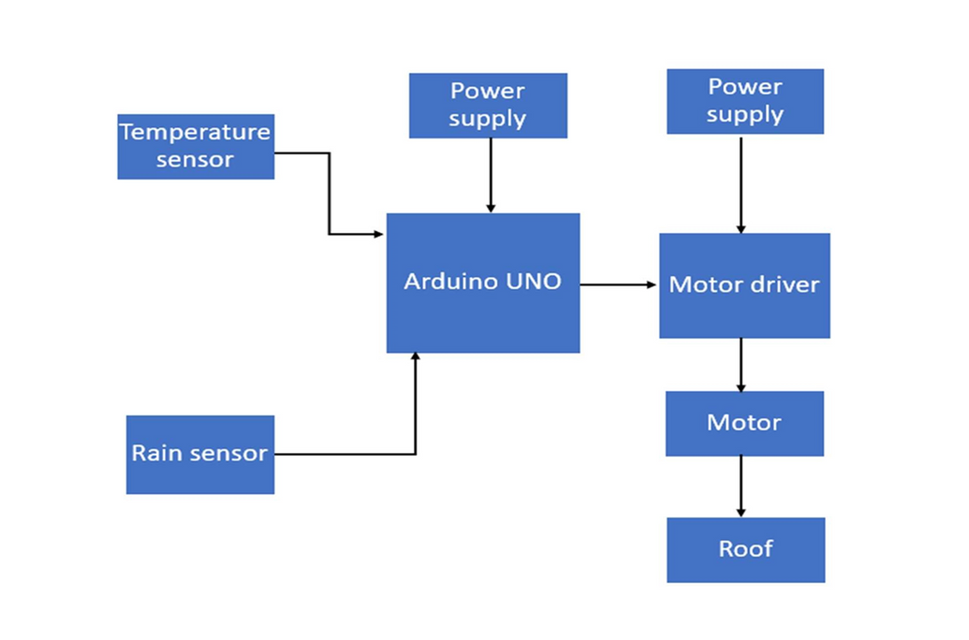
Hardware Requirements:-
Arduino UNO
Motor Driver
Motor
Rain Detecting Sensor
Battery
Jumper Wires
System Design &
Methodology
Software Requirements:-
Arduino IDE

Slide 7
Expected Results
Efficient automatic deployment/retraction of shelter
Reduced user intervention
Enhanced safety and convenience
Energy/water savings
Reliable operation in various weather conditions

Slide 8
Applications
Automatic Roof for Crop
Sports (Stadiums)
Parked Car at Remote Stations
Outdoor Events
Residential areas(backyards/patios)
Public Parks and Recreation Areas

Slide 9
Conclusion
With various applications in outdoor seating areas, public transportation, residential and commercial spaces, this system has the potential to improve daily life and mitigate the inconveniences of sudden rain.
Future Scope:
1. Integration with smart city infrastructure
2. Expansion to other weather conditions (e.g., sun, wind)
3. Incorporating solar panels for sustainable energy
4. Developing mobile app controls for user customization

Slide 10
Reference
T.JaswanthYadav, E. Naga Harini B. Manoj Shankar(2023) BY IEEE Contribution:-the automatic roof for crop this taskseems to be to protect the seedlings against unusual rain (link: https://ieeexplore.ieee.org/document/10150139)
Kirti Masown, Rajesh Mehra (2019) BY IEEE Contribution:-the Protection Covers for Parked Car covers from distant areas to provide protection to car from rain (link:-https://ieeexplore.ieee.org/document/8988500)
Published in: 2021 6th International Conference on Intelligent Computing and Signal Processing (ICSP) Date of Conference: 09-11 April 2021 Date Added to IEEE Xplore: 26 April 2021 Author :- Li Ru, Zhai Shu-ying
Published in: 2021 International Conference on Artificial Intelligence, Big Data, Computing and Data Communication Systems (icABCD) Date of Conference: 05-06 August 2021 Date Added to IEEE Xplore: 30 August 2021 Author:-Malusi Sibiya, Bernardus C.

Slide 11

Thank you

